Slide 1
Bulletproof Transient Error Handling with Polly
Joel Hulen
Notes:
Abstract:
Connected applications only work when connected. What happens if the network breaks temporarily? Will your system recover smoothly or pitch a fit? Using an OSS project called Polly (available on GitHub) you can handle this and many other transient situations with elegance and fluency. Polly let’s you define resilience and load-handling policies such as retry, wait and retry, circuit breaker, bulkhead isolation and timeouts and more. Learn how to make your system bulletproof with Polly and a little know-how.

Slide 2











Joel Hulen
Software Engineer / Data Engineer / Cloud Architect
30+ years in the industry
Author/co-author of several books on Azure
joelhulen@gmail.com
https://github.com/joelhulen
https://bit.ly/joelhulen

Slide 3

Notes:
Story of App vNext.

Slide 4
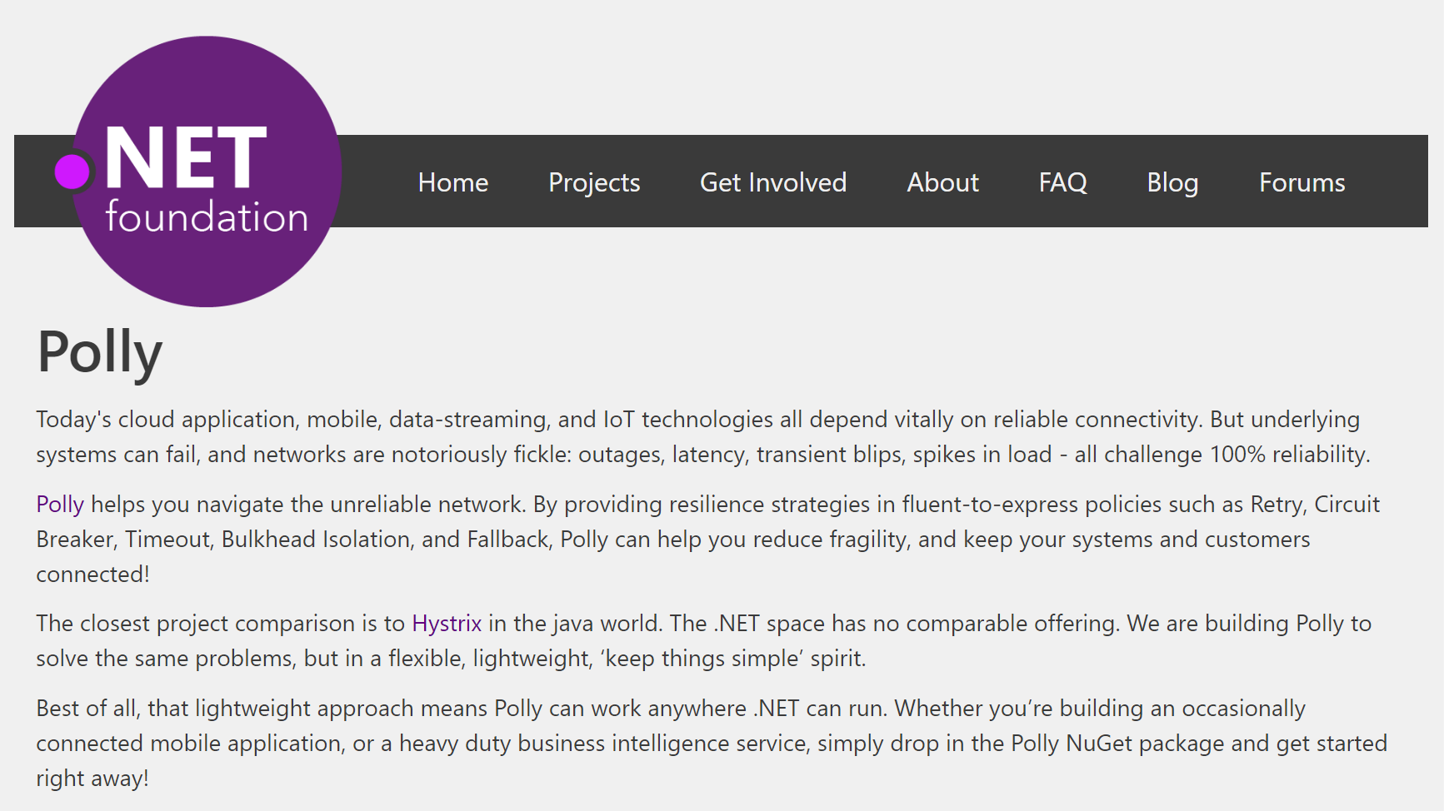
Notes:
Polly was accepted into the .NET Foundation in October, 2016!!

Slide 5
Transient Errors
Network outages
Service outages
Denial of Service attacks
IO locks
Connected device failures
Constrained resources

Slide 6
What happens when you flood a struggling service with requests?

Slide 7

Notes:
Ladies throwing chocolates over their shoulders / into mouths = downstream system can’t cope, *dropping requests*

Slide 8

Polly to the rescue!
.NET 4.5+ / .NET Standard 1.1 / .NET Std 2.0+ / .NET Core 2.1+
Fluently express transient exception handling strategies:
Retry, Circuit Breaker, Timeout,
Rate-Limiting/Bulkhead Isolation, Fallback,
Hedging, Chaos Engineering
https://github.com/App-vNext/Polly
Nuget: dotnet add package Polly.Core

Slide 9
Polly offers multiple resilience strategies ...
Retry … ‘Maybe it’s just a blip’
Circuit Breaker … ‘That system is down / struggling’
Timeout … ‘Don’t wait forever!’
Rate Limiter … ‘Don’t overload the system (yours or theirs)’
Bulkhead isolation … ‘One fault shouldn’t sink the whole ship’
Hedging … ‘I want the fastest response to my request’
Fallback … ‘If all else fails … degrade gracefully’
All strategies can be combined for multiple protection!

Slide 10
History of Polly
2013 Michael Wolfenden invents Polly 2015 Scott Hanselman (Microsoft) recommends Polly! Thoughtworks (Martin Fowler et al) recommend Polly!
Dec 2015 App-vNext takes stewardship. Full async support. Apr 2016 Advanced circuit breaker. Jul 2016 Handle return values as faults. Oct 2016 Timeout, Bulkhead Isolation, Fallback, PolicyWrap 2017 Cache, PolicyRegistry, InnerExceptions, RetryAfter, Jitter 2018 Deep integration into .NET Core 2.1, HttpClientFactory 2019 Custom policies, Sourcelink, Simmy (chaos injection) 2023 Major overhaul with Microsoft .NET team for performance
Notes:
RetryAfter: Honors servers which return 429 status codes (“Retry-After: x milliseconds”), when servers rate-limit consumers.
Jitter: adds some randomisation to retry intervals, so that the retries themselves don’t become spikes in load.

Slide 11
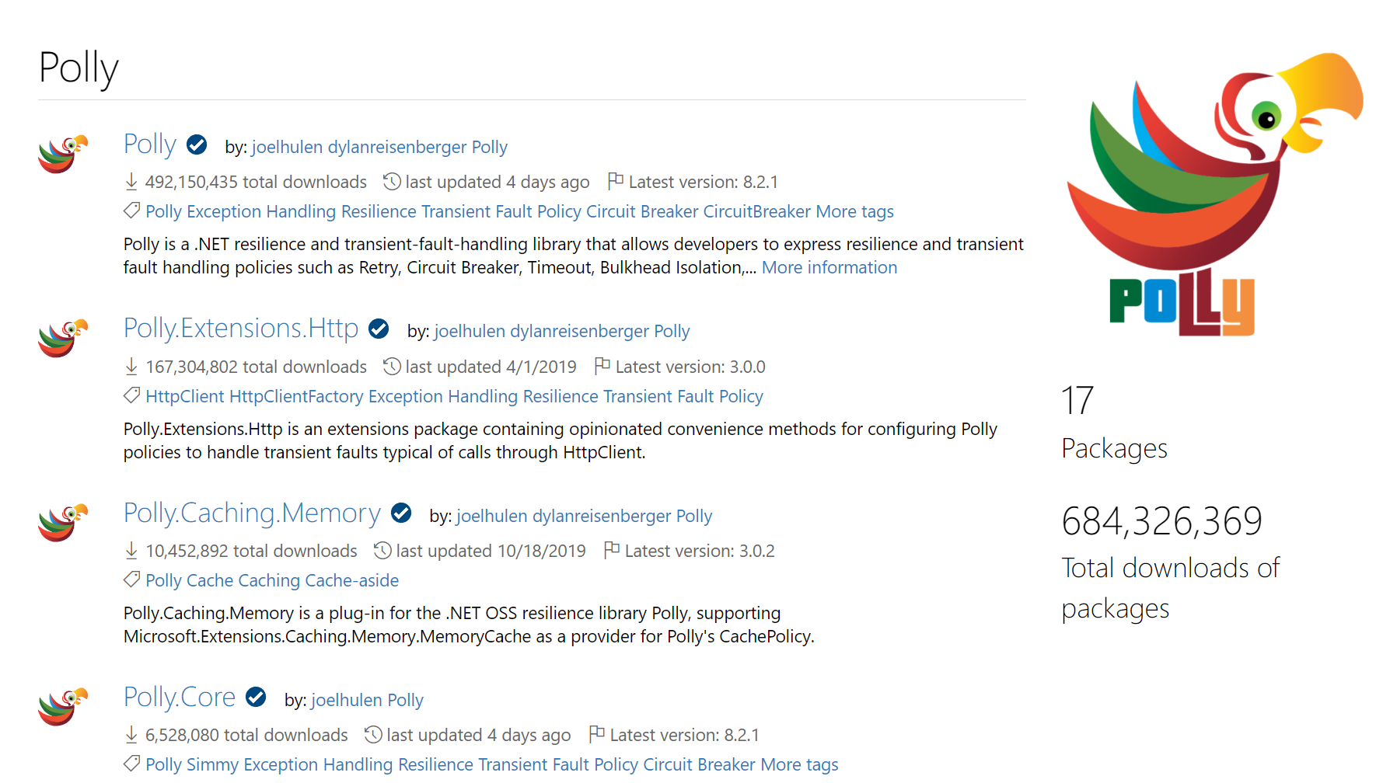
Polly ADOPTION
Cumulative for all Polly packages since May 2023: ~685 million
Directly used by ~2.3k NuGet packages
Used by .NET Resilience libraries
Notes:
Nov 2019: Running at three million downloads every six weeks (70k per day)

Slide 12
Polly v8 vs. v7
The term Policy is now replaced with Strategy
Resilience Pipelines: Combines one or more resilience strategies - similar to the Policy Wrap in previous versions
Unified sync and async flows: The resilience pipeline supports both synchronous and asynchronous execution flows
Native async support from the start
No static APIs: Improves testability, extensibility, and ease of use
Options-based configuration
Built-in telemetry
Notes:
Nov 2019: Running at three million downloads every six weeks (70k per day)

Slide 13
Polly v8 Performance Improvements
Polly v8 vastly improves performance and memory usage. It avoids allocations wherever possible, and we continuously track performance with comprehensive benchmarks
Benchmarks for advanced pipeline using Timeout (outer), Rate limiter, Retry, Circuit breaker, Timeout (inner):
Method | Mean | Error | StdDev | Ratio | RatioSD | Gen0 | Allocated | Alloc Ratio
Execute policy v7 | 2.277 μs | 0.0133 μs | 0.0191 μs | 1.00 | 0.00 | 0.1106 | 2824 B | 1.00
Execute pipeline v8 | 2.089 μs | 0.0105 μs | 0.0157 μs | 0.92 | 0.01 | - | 40 B | 0.01
Notes:
Nov 2019: Running at three million downloads every six weeks (70k per day)

Slide 14
Step 1: Define Resilience Pipeline
var pipeline = ResiliencePipelineBuilder
.AddRetry<new RetryStrategyOptions>()
.AddTimeout(TimeSpan.FromSeconds(10))
.Build();

Slide 15
Step 2: Execute with Pipeline
var response = pipeline.Execute(static () => { DoSomething() });
… or execute the same pipeline asynchronously:
var response = await pipeline.ExecuteAsync(static async token => { DoSomething() }, cancellationToken);

Slide 16
Retry Patterns
Retry immediately on failure. Specify number of retries.
Wait and Retry Retry with a timeout in between each try. Change the timeout between each retry, eg exponential back-off, jitter.
Retry Forever Keep retrying until succeeds.
Retry addresses ... ‘It’s probably a blip. Give it another go - it might succeed.’

Slide 17
Circuit Breaker
Circuit Breaker Breaks the circuit for a configured period if too many errors occur
Blocks calls while circuit is broken.
Protects downstream system - chance to recover.
Fail fast to the caller to prevent cascading effects.
Circuit Breaker addresses … ‘Whoa, that system is struggling / down. Give it a break. And don’t hang around waiting for an answer that’s unlikely right now!’
Notes:
Circuit-Breaker: = The ladies in the video (= downstream system) are having a meltdown: so give them a break.
Stop sending chocolates down the line for a while, so they can recover (and if the calls/chocolates are only going to be dropped anyway, why send ‘em? Fail fast instead - don’t try calls which are unlikely to succeed!)
So: Fail fast = better user experience, if the call is likely to fail anyway.
*Original Circuit-Breaker*, trigger to break = too many chocolates in a row get dropped.
*Advanced Circuit-Breaker*, trigger to break = too high proportion of chocolates get dropped.

Slide 18
Timeout
Timeout Stop waiting once you think an answer will not come
Optimistic mode Co-operative timeout via CancellationToken
Timeout ensures … callers can ‘walk away’ from a faulting downstream system, release blocked threads/connections etc.

Slide 19
Rate Limiter
Rate limiter resilience strategy Controls the # of operations that can pass through it.
Use the rate limiter to limit the incoming requests during a given period (window).
Use the concurrency limiter to limit the outgoing concurrent request count against a resource.
Rate limiter … ‘Protect a constrained resource and avoid overwhelming my app while keeping traffic at a safe level’
Notes:
Rate limiting is the concept of limiting how much a resource can be accessed. For example, you know that a database your application accesses can handle 1000 requests per minute safely, but are not confident that it can handle much more than that. You can put a rate limiter in your application that allows 1000 requests every minute and rejects any more requests before they can access the database. Thus, rate limiting your database and allowing your application to handle a safe number of requests without potentially having bad failures from your database.

Slide 20
Bulkhead Isolation – Rate Limiter
Bulkhead Prevents one operation from consuming more than its fair share of resources.
Imagine one stream of calls starts faulting slowly...
All threads in a caller could end up waiting on that system … until it starves the caller doing anything else.
Bulkhead prevents this, by limiting the resources (threads etc) a given call stream can consume.
Bulkhead was an individual strategy in v7 – implement with ConcurrencyLimiter (from Polly.RateLimiting) in v8
Bulkhead … ‘One fault shouldn’t sink the whole ship!’
Notes:
Source of bulkhead idea: Large ocean vessels are divided (inside the hull) into separate bulkheads. These can be sealed off (from one another). Idea: if ship damaged, only one bulkhead floods (each sealed off). One fault doesn’t sink the whole ship!
Related software principle: Limit the resources consumable by different operations, so that one faulting stream of calls can’t ‘sink’ the whole system.
Implementation = a simple parallelism throttle (SemaphoreSlim).
Analogy: Supermarkets reserve separate groups of check-outs for “shopping carts” versus “baskets only” or “12 items or fewer”. This is bulkhead isolation. If they didn’t isolate different streams (if was all mixed), and there was a glut of large shopping carts going through, the large carts would flood all checkout aisles, use all capacity; this would prevent people with only small baskets also checking out quickly. By reserving some aisles for “baskets only”, those people with baskets-only can always checkout quick. Bulkhead isolation = separate defined capacity for different operations.
( Alternative similar analogy: airline check-in. There’s always a reserved check-in queue (reserved capacity) for first-class check-in. )
Analogy: think of those full shopping carts as slow-responding / heavy-payload / faulty endpoints on your service. Do you want those faulting calls to have the potential to gobble all resource, and also stop the other endpoints responding?
Bulkhead also = pro-active load-shedder. Intentionally sheds load, when parallelism exceeded.
Why pro-actively shed load? (in advance of the server/service’s maximum capacity)
Because failing predictably (in a managed/controlled fashion) is better than failing in unpredictable or unexpected ways.
Analogy: humans drinking. Not having pro-active load management is like someone saying they know when they’ve drunk too much because they pass out or start behaving chaotically. Do you want to leave your servers unbounded, to “drink so many requests” that they start behaving chaotically or keel over? No? So: think about pro-active load-shedding.
Best: monitor bulkhead capacity; use full/near-full bulkhead as trigger for horizontal scaling.

Slide 21
Hedging
Execute more than one invocation if the original failed or is considered too slow. Run invocations sequentially or concurrently.
Set Delay > 0 seconds to run sequentially and issue a new one only if the previous one takes too long
Set Delay < 0 seconds to run sequentially and issue a new one only if the previous one failed
Set Delay = 0 seconds to run concurrently and wait only for the fastest one to complete
Hedging addresses … ‘I want the fastest response to my request’

Slide 22
Fallback
Fallback Specifies a substitute value to provide (or action to run) when an operation still fails.
Fallback addresses … ‘Failures will occur … prepare how you will respond when that happens’

Slide 23
Strategy Basics
Define how transient exceptions should be handled
Fluent and concise
Thread-safe
Reusable across call sites
Sync or async
Chain policies together
Apply to any Action or Func (service calls, data stores, web requests, mobile connectivity)
Notes:
All these resilience patterns are brilliantly covered in Michael Nygard’s book Release It!

Slide 24
Demos
https://github.com/App-vNext/Polly-Samples

Slide 25
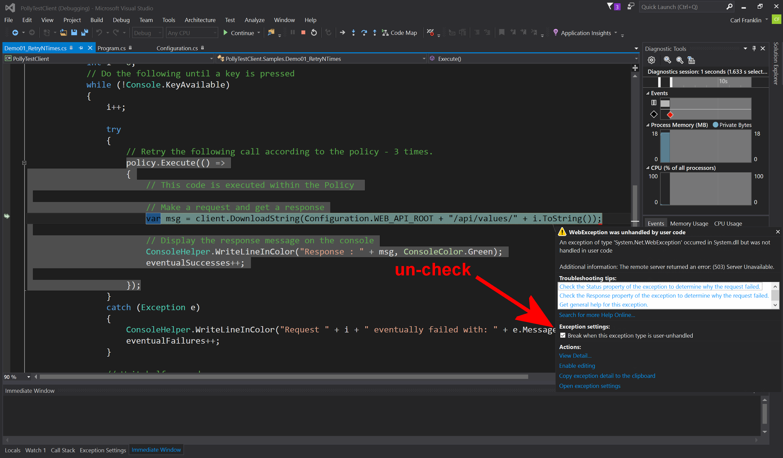
Notes:
Uncheck this tickbox if demoing the Samples out of Visual Studio simply by pressing F5 for Debug. Or ctrl-F5 for start-without-debug.

Slide 26
Further features
Use predicates to filter exceptions handled:
var options = new RetryStrategyOptions<HttpResponseMessage> { ShouldHandle = args => args.Outcome switch { { Exception: HttpRequestException } => PredicateResult.True(), { Exception: TimeoutRejectedException } => PredicateResult.True(), { Exception: HttpResponseMessage response } when ~response.IsSuccessStatusCode => PredicateResult.True(), _ => PredicateResult.False() } }

Slide 27
Further features
Use the Predicate builder to simplify:
var options = new RetryStrategyOptions<HttpResponseMessage> { ShouldHandle = new PredicateBuilder<HttpResponseMessage>() .HandleResult(response => !response.IsSuccessStatusCode) .Handle<HttpRequestException>() .Handle<TimeoutRejectedException>() }
Please note that using the switch expression in the previous example provides the best performance.

Slide 28
Further features
Handle both exceptions and return values within the same strategy. Ideal for HttpClient:
new ResiliencePipelineBuilder<HttpResponseMessage>().AddRetry(new RetryStrategyOptions<HttpResponseMessage> { ShouldHandle = new PredicateBuilder<HttpResponseMessage>() .Handle<SomeExceptionType>() .HandleResult(static result => response.StatusCode == HttpStatusCode.InternalServerError), MaxRetryAttempts = 3, }) .Build();

Slide 29
Further features
ResiliencePipelineRegistry: Create and cache resilience pipeline instances. Retrieve by string or complex key.
+ separate policy config (at startup) from usage
+ promotes DI: inject the registry to controllers/services
+ dynamically update policies in the registry, for dynamic reconfiguration during running. Tweak timeouts, circuit-breaker sensitivity, etc. in production. Supports dynamic reloading of resilience pipelines with configs change.
+ Automatic resource management and caching of resilience pipelines
Notes:
Bullet 3 – Dynamic Reconfiguration:
In some applications, it can be useful to be able to reconfigure policies dynamically without restarting the process.
Eg You might want to tweak circuit-breaking thresholds to be more or less sensitive according to conditions in production.
With PolicyRegistry, you simply replace the policy in the registry with a new one, when the underlying configuration source is detected to have changed.
More at: https://github.com/App-vNext/Polly/wiki/Dynamic-reconfiguration-during-running

Slide 30
INTEGRATION WITH .NET Core / .NET 8
Microsoft has created two NuGet packages built on top of Polly, which add a few default strategies and enriched metrics for hardening apps and handling HttpClient resilience:
+ Microsoft.Extensions.Resilience: For all types of applications + Microsoft.Extensions.Http.Resilience: Resilience mechanisms specifically for the HttpClient class
Notes:
Notes on HttpClientFactory: (beyond Polly)
Part of .NET Core 2.1. Usable in ASP.NET Core or in .NET Core microservice apps.
Fluent syntax for configuring HttpClient instances with Polly policies governing calls
Provides a central location for naming and configuring logical HttpClients. For example, you may configure a client that is pre-configured to access the github API.
Manages the lifecycle of HttpClient instances – deals with earlier confusion about how frequently to recycle/dispose HttpClient instances, for performance and to capture DNS changes
Polly wiki has full details. Scott Hanselman and Steve Gordon have written excellent blog posts.

Slide 31
INTEGRATION WITH .NET Core / .NET 8
Deep integration with HttpClientFactory. Configure HttpClient variants for DI at startup. dotnet add package Microsoft.Extensions.Http.Resilience
builder.Services .AddHttpClient(“GitHub”, client => { client.BaseAddress = new Uri("https://api.github.com/"); }) .AddStandardResilienceHandler());
All calls through that client will use the standard resilience strategies, chained in the following order (outer to inner): Rate limiter, total request timeout, retry, circuit breaker, attempt timeout.
Configured client can be DI-injected anywhere in app.
Notes:
Notes on HttpClientFactory: (beyond Polly)
Part of .NET Core 2.1. Usable in ASP.NET Core or in .NET Core microservice apps.
Fluent syntax for configuring HttpClient instances with Polly policies governing calls
Provides a central location for naming and configuring logical HttpClients. For example, you may configure a client that is pre-configured to access the github API.
Manages the lifecycle of HttpClient instances – deals with earlier confusion about how frequently to recycle/dispose HttpClient instances, for performance and to capture DNS changes
Polly wiki has full details. Scott Hanselman and Steve Gordon have written excellent blog posts.

Slide 32
SIMMY – CHAOS ENGINEERING with Polly
Selectively inject failures in prod/pre-prod.
var chaosPolicy = Policy.InjectFault<SocketException>( faultRate: 0.005, // fail randomly 0.5% of the time enabled: () => isEnabled() // Func<bool>, can toggle on/off );
Embed chaos-injection policies into prod/any environment.
Turn chaos experiments on/off easily by config.
Vary fault rates to explore system resilience.
Notes:
Feature PR complete – releases in next few weeks.
Final syntax TBC.
Details via Polly website.

Slide 33
SIMMY – CHAOS ENGINEERING with Polly
Selectively inject latency in prod/pre-prod.
var chaosPolicy = Policy.InjectLatency( latency: TimeSpan.FromSeconds(2), // or randomized faultRate: 0.02, // add latency 2% of the time enabled: () => isEnabled() // Func<bool>, can toggle on/off );
Embed chaos-injection policies into deployments.
Low overhead: ~1 microsecond (1/millionth sec) when off.
Notes:
Feature PR complete – releases in next few weeks.
Final syntax TBC.
Details via Polly website.

Slide 34
SIMMY – FAKE FAILURES FOR TESTS
Unit testing your services - easily fake results for any execution guarded by Polly.
var failure = Policy.InjectResult<HttpResponseMessage> (new HttpResponseMessage(HttpStatusCode.RequestTimeout));
Pass the failure policy into your component-under-test by DI.
Unit-test how your services/outbound calls handle failures.
Notes:
Feature PR complete – releases in next few weeks.
Final syntax TBC.
Details via Polly website.

Slide 35
SIMMY – CHAOS ENGINEERING with POLLY
Fully configurable
+ all fault types configurable with dynamic Funcs
+ contextual: inject faults only on specific call paths
Upcoming Polly v8 release will include Simmy chaos strategies natively!
https://github.com/Polly-Contrib/Simmy

Slide 36
Distributed Circuit Breaker
Distributed circuit-breaker backed by a state store (Azure Durable Entity Functions)
Use within Azure Functions
Or consume from anywhere, over https
Stateful and consistent across distributed callers, across function app scale out
https://github.com/Polly-Contrib/ Polly.Contrib.AzureFunctions.CircuitBreaker
Notes:
Serverless functions and Actors are inherently stateless or short-lived. So they can’t maintain circuit stats (“how many calls have failed?”) across calls. And they often exist in multiple instances horizontally scaled. So they need to store and track the circuit state externally.

Slide 37
Options for other languages/platforms?
Javascript: polly-js, pollyjs Strategies: retry, retry and wait
Repo: https://github.com/mauricedb/polly-js
Repo: https://github.com/Netflix/pollyjs
Java/Scala: Hystrix (by Netflix) Strategies: circuit breaker, fallback, bulkhead isolation
Repo: https://github.com/Netflix/Hystrix
Python: tenacity Strategies: retry, retry and wait
Repo: https://github.com/jd/tenacity
Notes:
The polly-js library is based on the Polly .NET library, offering a small subset of capability through retry and retry/wait policies.
Hystrix is a robust reslilience framework by Netflix, but is no longer in development as of early 2018 when Netflix decided to end active development. The original engineers moved on. Hopefully this will be taken up by other contributors.

Slide 38
Options for other languages/platforms?
Javascript polly-js retry example.
polly()
.retry(2)
.executeForPromise(function () {
return requestPromise('http://www.google.com');
})
.then(function(result) {
console.log(result)
}, function(err) {
console.error('Failed trying three times', err)
});
Notes:
Feature PR complete – releases in next few weeks.
Final syntax TBC.
Details via Polly website.

Slide 39
Options for other languages/platforms?
Java Hystrix circuit breaker with fallback example.
import com.netflix.hystrix.contrib.javanica.annotation.HystrixCommand;
...
@HystrixCommand(fallbackMethod = "reliable")
public String readingList() {
URI uri = URI.create("http://localhost:8090/recommended");
return this.restTemplate.getForObject(uri, String.class);
}
public String reliable() {
return "Cloud Native Java (O'Reilly)";
}
}
Notes:
Feature PR complete – releases in next few weeks.
Final syntax TBC.
Details via Polly website.

Slide 40
Options for other languages/platforms?
Python tenacity retry example.
@retry(wait=wait_exponential(multiplier=1, min=4, max=10))
def wait_exponential_1():
print("Wait 2^x * 1 second between each retry starting with 4 seconds, then up to 10 seconds, then 10 seconds afterwards")
raise Exception
Notes:
Feature PR complete – releases in next few weeks.
Final syntax TBC.
Details via Polly website.

Slide 41
Polly Repo, Slack channel, Docs, and Blog
https://github.com/App-vNext/Polly (repo)
https://www.pollydocs.org (docs)
https://pollytalk.slack.com (slack)
http://www.thepollyproject.org/ (blog)

Slide 42
THANK YOU!
Notes:
Abstract:
Connected applications only work when connected. What happens if the network breaks temporarily? Will your system recover smoothly or pitch a fit? Using an OSS project called Polly (available on GitHub) you can handle this and many other transient situations with elegance and fluency. Polly let’s you define resilience and load-handling policies such as retry, wait and retry, circuit breaker, bulkhead isolation and timeouts and more. Learn how to make your system bulletproof with Polly and a little know-how.

